Slide 1


Happy with GraphQL
Dmitrii Golikov
SUBBOTNIK

Slide 2

SPA

Slide 3
Single Page Application
Client Side Rendering
SPA
Client Side Routing

Slide 4
REST API
HTTP методы: GET, POST, PUT, DELETE
HTTP коды, такие как 200, 201, 404, 403 т.д.
Один endpoint - одна сущность

Slide 5
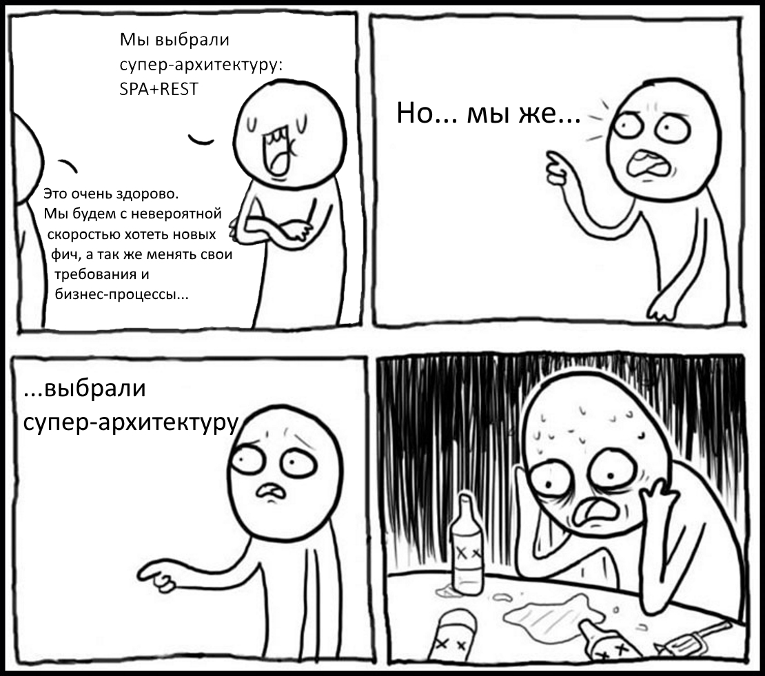

Slide 6
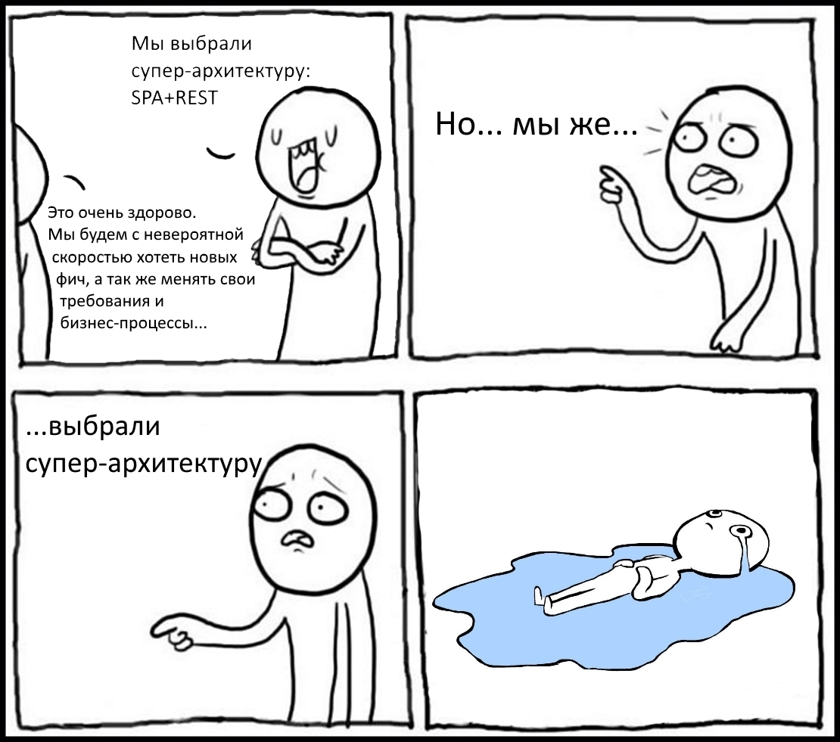

Slide 7
REST API
Большое количество запросов на сервер
Большое количество лишних данных
Множество custom endpoints
Обеспечение обратной совместимости
Нет удобного инструмента
Данные не синхронизированы

Slide 8

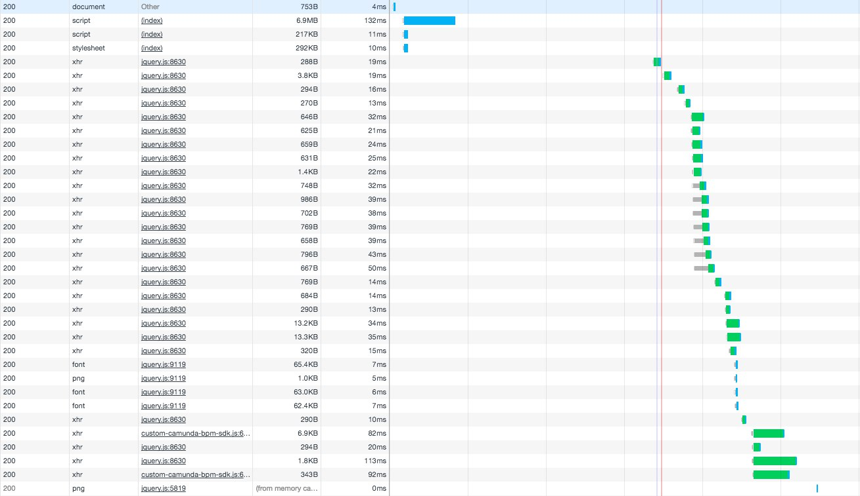
REST API

Slide 9
REST API
Прокаченные endpoints:
Строка фильтрации
Умные custom endpoints
Строка сортировки
Клиентское кэширование
Строка для fetching-а
Генерация raml
Строка для id_fetching-а
Сохранение, изменение вместе с вложениями

Slide 10





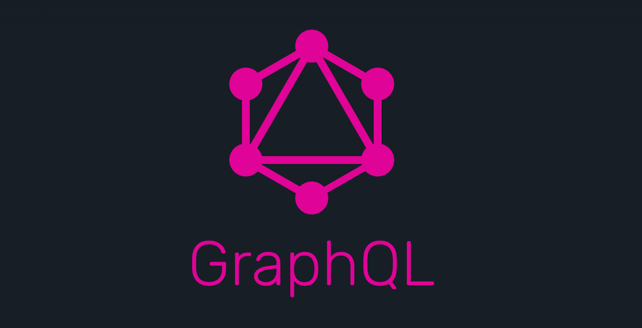
Новый проект
Выбор технологий
Серверный рендеринг
SEO-friendly
из коробки

Slide 11
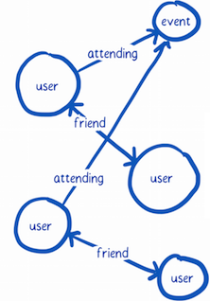

Slide 12
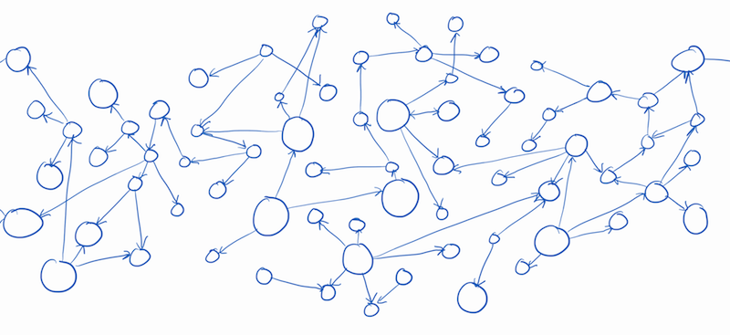

Slide 13
A query language for your API
GraphQL is a query language for APIs and a runtime for fulfilling those queries with your existing data. GraphQL provides a complete and understandable description of the data in your API, gives clients the power to ask for exactly what they need and nothing more, makes it easier to evolve APIs over time, and enables powerful developer tools.
A query language for your API
GraphQL is a query language for APIs and a runtime for fulfilling those queries with your existing data. GraphQL provides a complete and understandable description of the data in your API, gives clients the power to ask for exactly what they need and nothing more, makes it easier to evolve APIs over time, and enables powerful developer tools.
A query language for your API
GraphQL is a query language for APIs and a runtime for fulfilling those queries with your existing data. GraphQL provides a complete and understandable description of the data in your API, gives clients the power to ask for exactly what they need and nothing more, makes it easier to evolve APIs over time, and enables powerful developer tools.
A query language for your API
GraphQL is a query language for APIs and a runtime for fulfilling those queries with your existing data. GraphQL provides a complete and understandable description of the data in your API, gives clients the power to ask for exactly what they need and nothing more, makes it easier to evolve APIs over time, and enables powerful developer tools.
A query language for your API
GraphQL is a query language for APIs and a runtime for fulfilling those queries with your existing data. GraphQL provides a complete and understandable description of the data in your API, gives clients the power to ask for exactly what they need and nothing more, makes it easier to evolve APIs over time, and enables powerful developer tools.
A query language for your API
GraphQL is a query language for APIs and a runtime for fulfilling those queries with your existing data. GraphQL provides a complete and understandable description of the data in your API, gives clients the power to ask for exactly what they need and nothing more, makes it easier to evolve APIs over time, and enables powerful developer tools.
A query language for your API
GraphQL is a query language for APIs and a runtime for fulfilling those queries with your existing data. GraphQL provides a complete and understandable description of the data in your API, gives clients the power to ask for exactly what they need and nothing more, makes it easier to evolve APIs over time, and enables powerful developer tools.
A query language for your API
GraphQL is a query language for APIs and a runtime for fulfilling those queries with your existing data. GraphQL provides a complete and understandable description of the data in your API, gives clients the power to ask for exactly what they need and nothing more, makes it easier to evolve APIs over time, and enables powerful developer tools.

Slide 14
GraphQL Server
Data Sources
Different
Client Apps
GraphQL Queries
JSON Payload

Slide 15
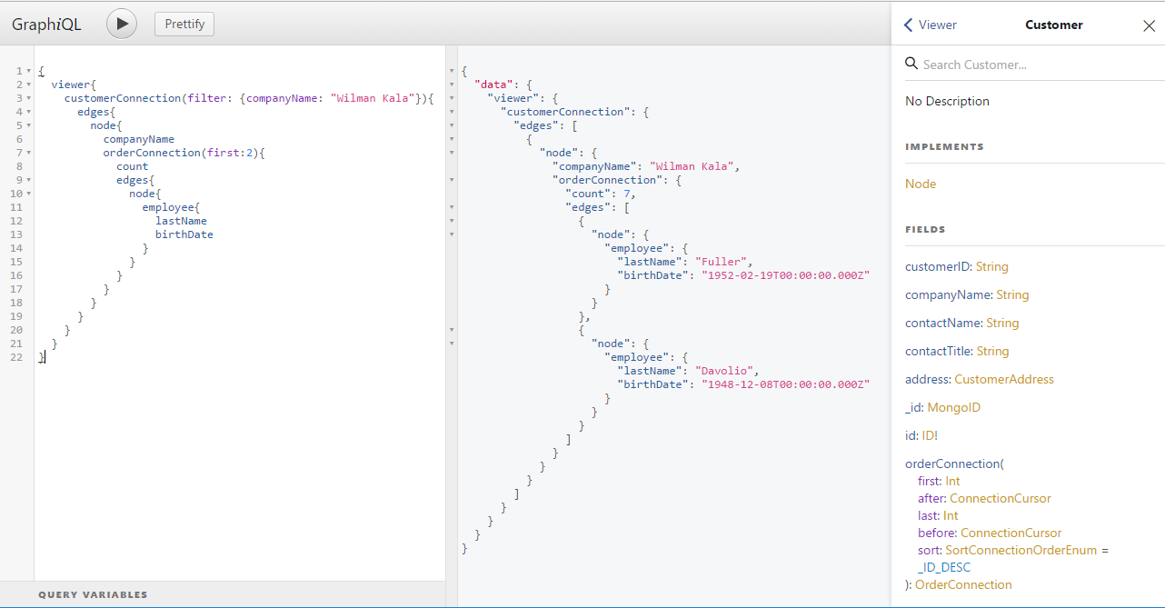
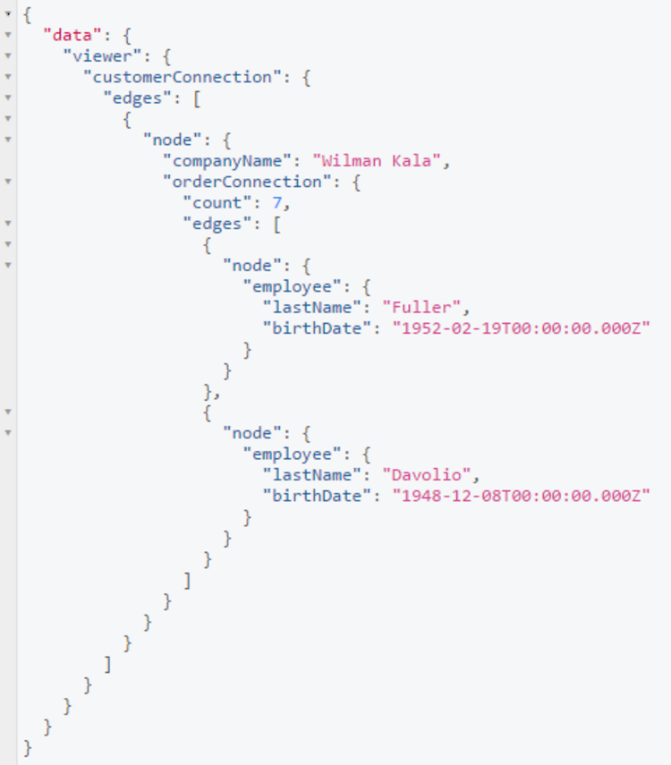
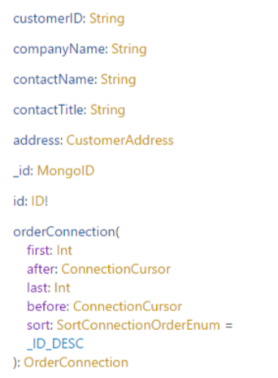
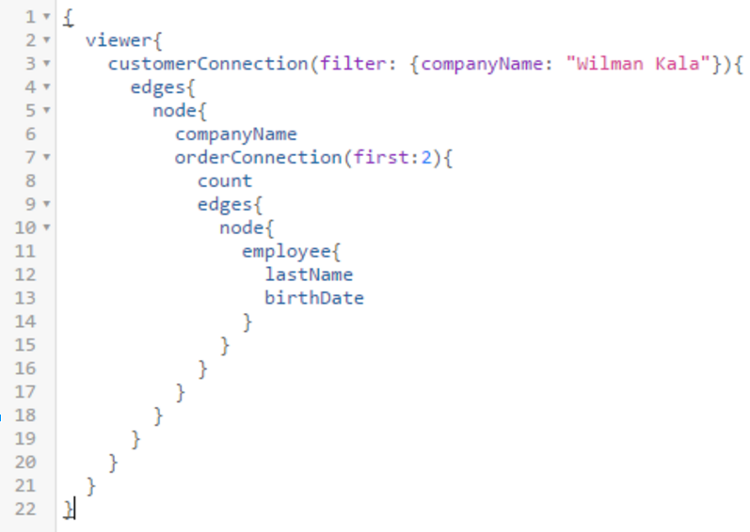
http://graphql-compose.herokuapp.com/northwind

Slide 16
A JAVASCRIPT FRAMEWORK FOR BUILDING DATA-DRIVEN REACT APPLICATIONS

Slide 17
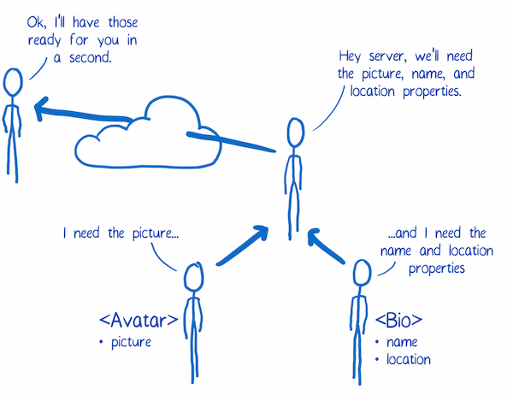

Slide 18

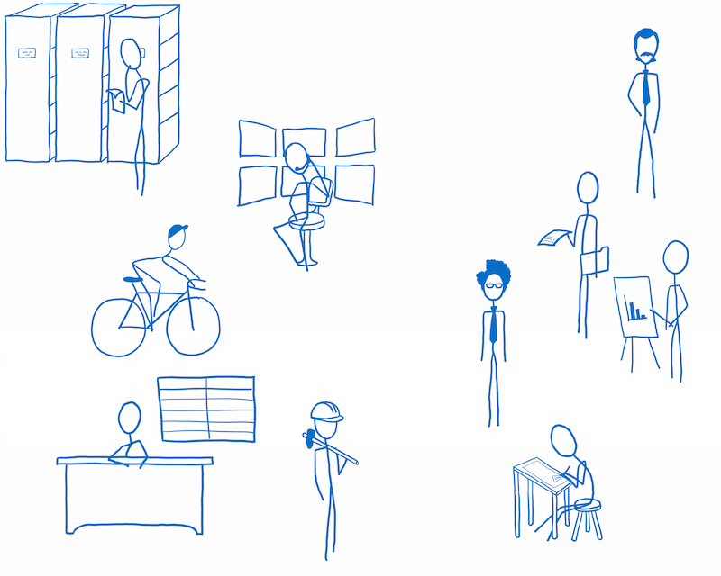

Slide 19
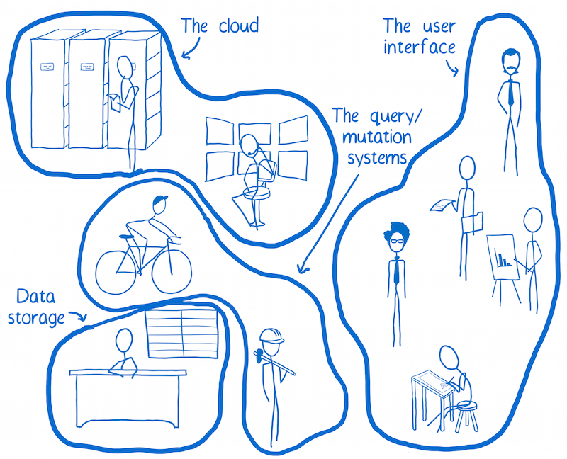

Slide 20


Slide 21
Было сложно разобраться
Нужно было изменить мышление

Slide 22
Достоинства и недостатки
меньше времени на разработку
мутации описываются огромным кодом
меньше запросов
не поддерживает то, у чего нет одного источника правды
меньше сетевого трафика
может быть очень большой запрос с клиента
меньше рисков
меньше коммуникаций
механизм подписок
отзывчивость
закрытый store
это прослойка
очень концентрированная документация

Slide 23
Libraries:
Javascript
Ruby
PHP
Python
Java
C/C++
Go
Scala
.NET
Elixir
Haskell
SQL
Lua
Elm
Clojure
Swift
OCaml
Rust

Slide 24
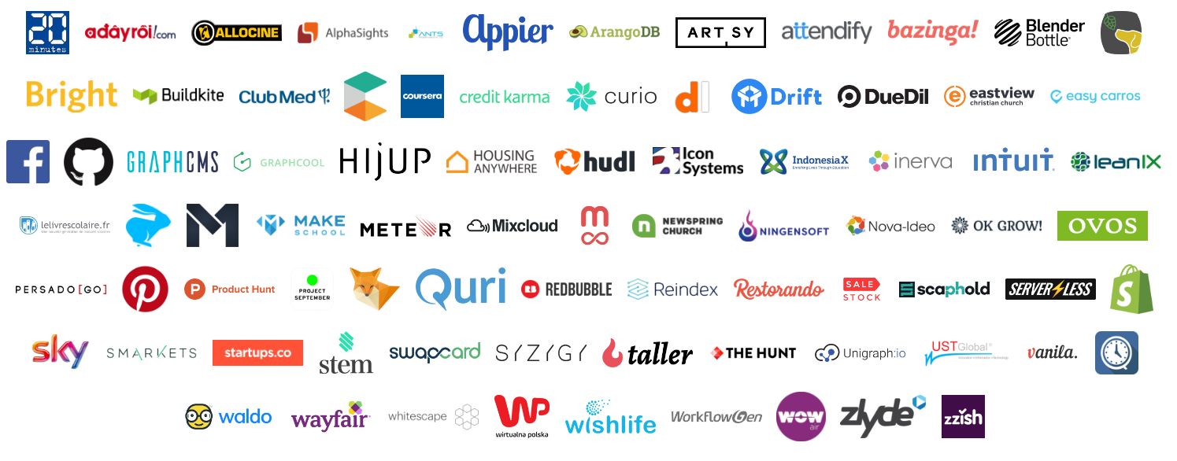


Slide 25


Slide 26

Useful links:
https://github.com/facebook/relay
http://www.apollodata.com/
https://github.com/chentsulin/awesome-graphql
https://habrahabr.ru/post/326986/
https://code-cartoons.com/

Slide 27


CONTACT ME
golikovdd@gmail.com
dany_guyverx

Slide 28
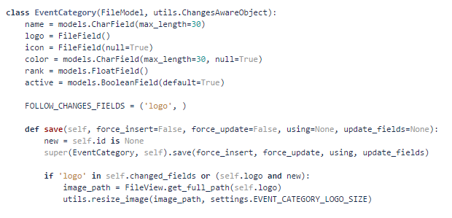

Slide 29
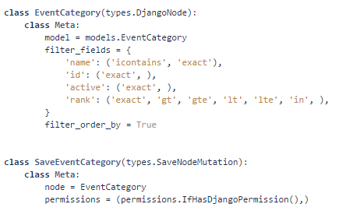

Slide 30
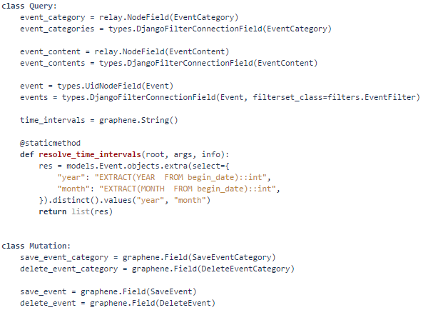

Slide 31
